Slide 1
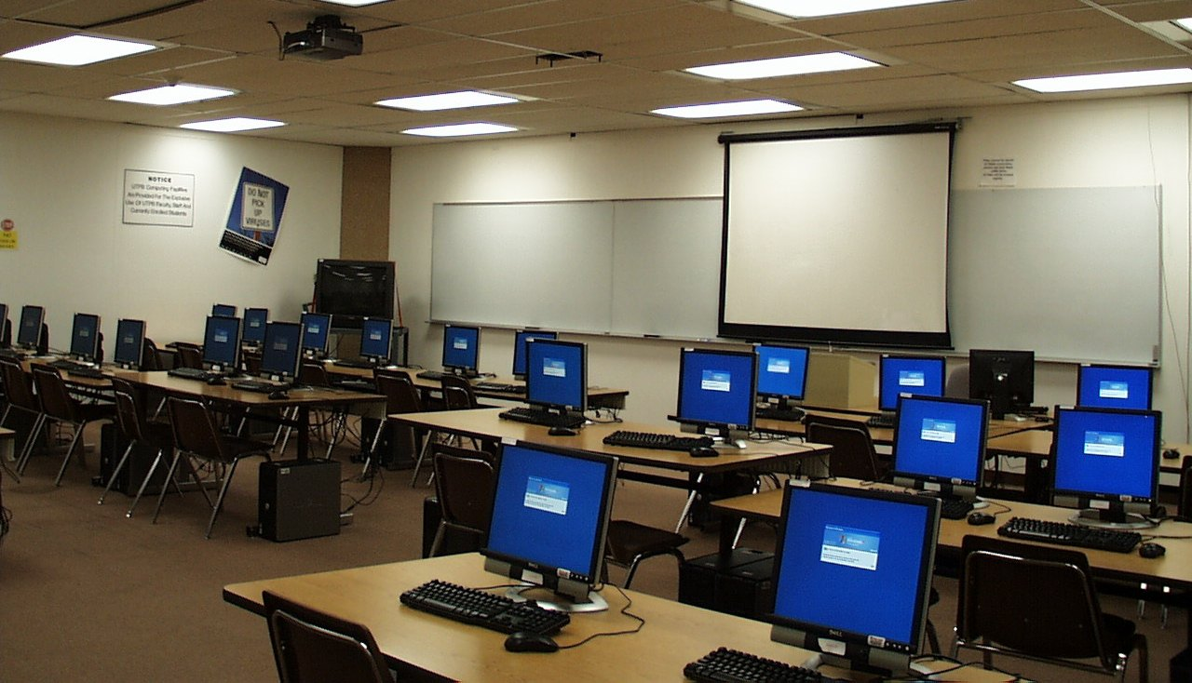


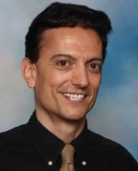


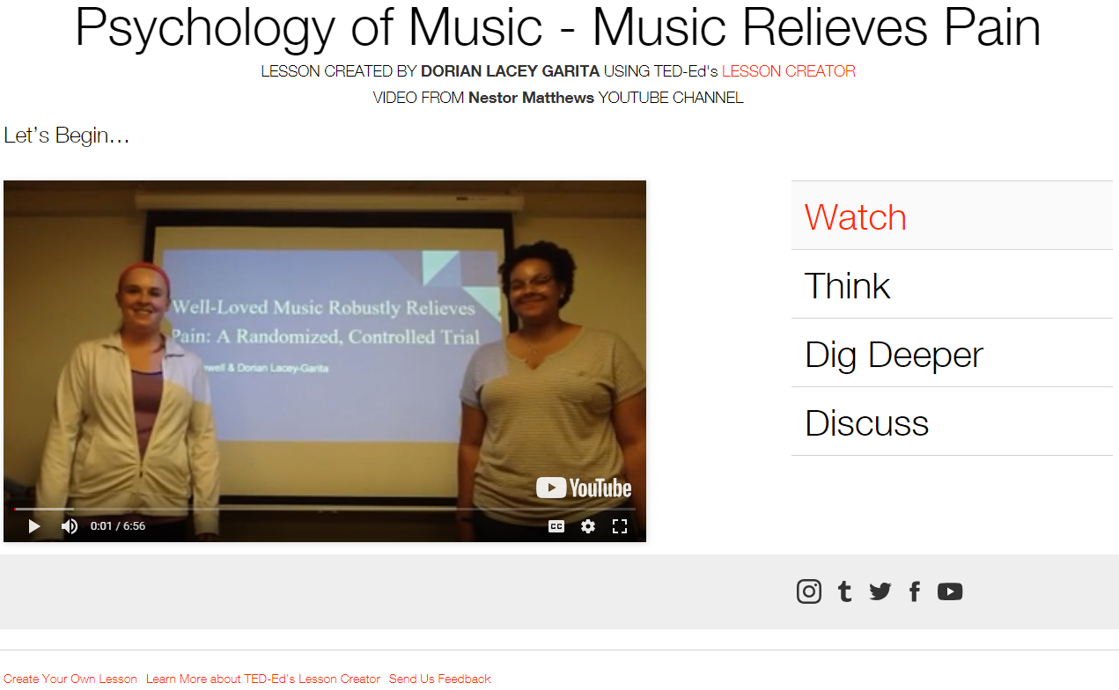
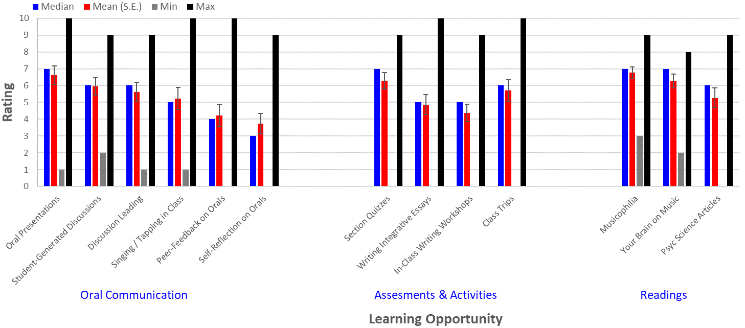
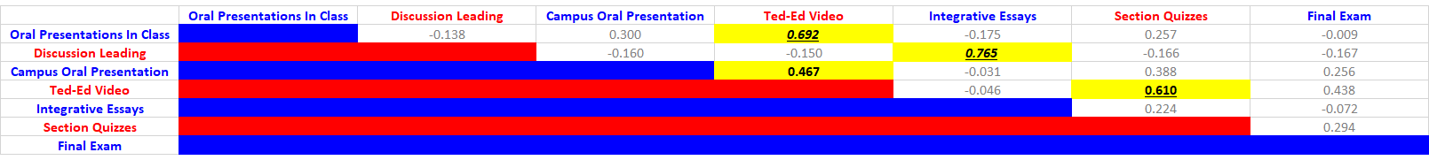
Oral Communication in the Psychology of Music
Nestor Matthews, Department of Psychology, Denison University
TED-Ed Lessons
Student-Generated TED-Ed Lessons: http://personal.denison.edu/~matthewsn/psychologyofmusic
Poster
Poster: http://personal.denison.edu/~matthewsn/nitop2019
Introduction
Results
The APA’s oral communication guidelines for the Psychology Major require students to
“exhibit effective presentation skills for different purposes” and “interact effectively with others”
(APA Guidelines, 2013, pp. 30-31). Those guidelines motivated my backward-designed and
flipped Psychology of Music course (N=20; spring 2017) and the following learning goals.
Goals – Students Will Learn to…
1. Communicate more effectively when speaking, writing, reading and listening;
2. Learn more effectively, via enhanced self-regulation and meta-cognition;
3. Integrate seemingly unrelated ideas;
4. Apply principles of psychological science to better understand music;
5. Critically evaluate scientific investigations of music.
Methods
Course Readings – Typical class periods scaffolded the topical content via a sequence of three readings. First, This is Your Brain on Music (Levitin, 2006) provided a foundation for students with no musical background. Second, Musicophilia (Sacks, 2007) show-cased observational research via qualitative neurological case studies. Third, Psychological Science articles on music served as primary sources for contextualizing more sophisticated research designs and their statistics.
Student Learning-Effectiveness Ratings
Before Each Class Period – On the evening before each class period, students generated and posted online either their PPT presentations, discussion-leading items, or potential exam questions. These items mapped onto the three above-noted readings for each class period. Across the semester, each student made three oral presentations (one on each above-noted source), and led three discussions (one on each above-noted source). The requirement to post items on the evening before class enhanced self-regulation, preparedness, and exploited sleep-related consolidation (see
“Relearn Faster and Retain Longer: Along with Practice, Sleep Makes Perfect”, Mazza et al., 2016).
Inside the Flipped Classroom – Each 80-minute class period comprised three ~25-minute sections. In the first section, a student pair made a formal APA-conference style ~12-minute PPT presentation on a selection from This is Your Brain on Music. A second student pair subsequently led a ~12 minute class discussion on that reading. The second and third ~25-minute sections repeated that format, but with the Musicophilia reading and Psychological Science article, respectively. Students who did not have a speaking role in a given session provided written peer-to-peer feedback on the PPT presentations during class. In this way, every student had an active role in class each session. Across the semester, each student had multiple opportunities to practice formal presentations and less formal interactive discussion-leading, per the above-noted APA guidelines. Each student also had multiple opportunities to work in pairs, practice providing constructive feedback, incorporate peer- and instructor-feedback, and complete written self-reflections. (See website for materials.)
Assessment Correlation Matrix
n.s.= Faded: p < 0.05 = Yellow Fill & Bold (r >= 0.444): p < 0.01 = Yellow Fill, Bold & Underlined (r >= 0.562): p < 0.001 = Yellow Fill, Bold, Underlined & Italic (r >= 0.680)
Course Capstone Project – In addition to the above scaffolding, the semester culminated in student-pairs making an oral presentation to a campus-wide audience, and a corresponding video-based TED-Ed lesson. These required students to learn about open-access resources while adapting their oral skills for audiences versed neither in music nor in psychological science. (See website TED-Eds.)
Bottom Line
Students generated video-based open access TED-Ed Lessons to practice oral communication in psychology, and promote the public’s understanding of the Psychology of Music. Please Share!

